Slide 1
Introduction To GAN’s
Presented by : Mohammad Samran Elahi.

Slide 2
Overview
Applications of GAN’s
How a GAN’s work
Losses used in GAN’s
Upsampling
Notebook
Cycle GAN’s (Overview)

Slide 3
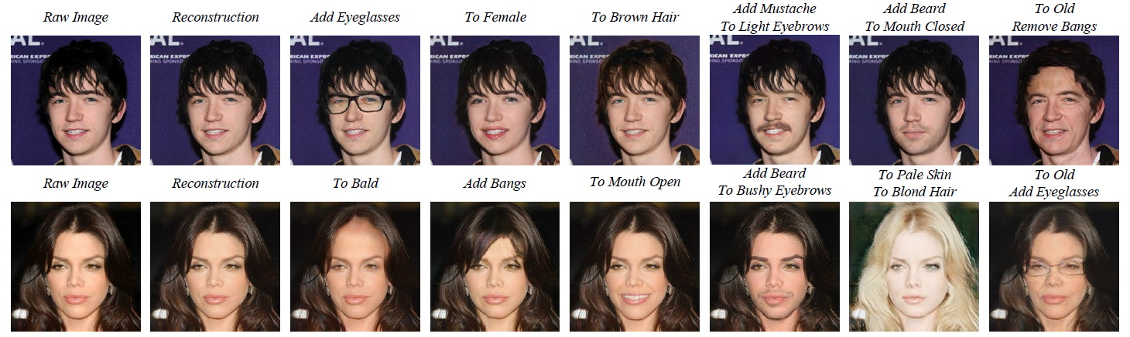
Applications
https://thispersondoesnotexist.com/
https://www.myheritage.com/deep-nostalgia

Slide 4
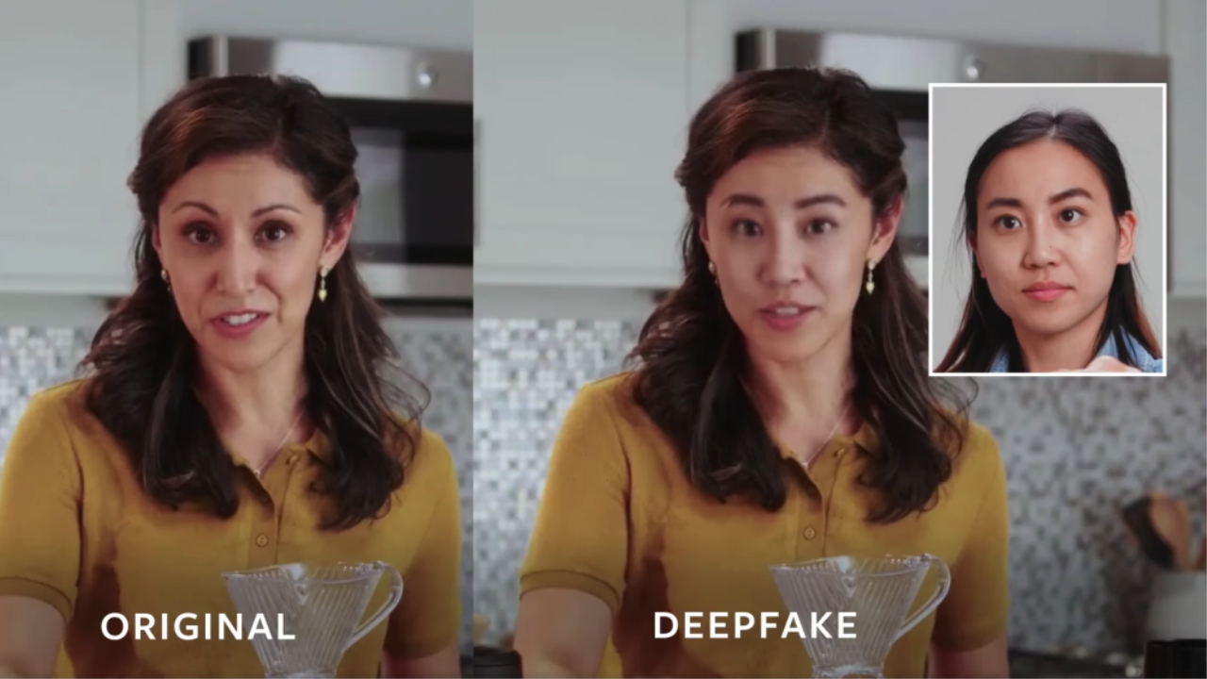
Applications

Slide 5
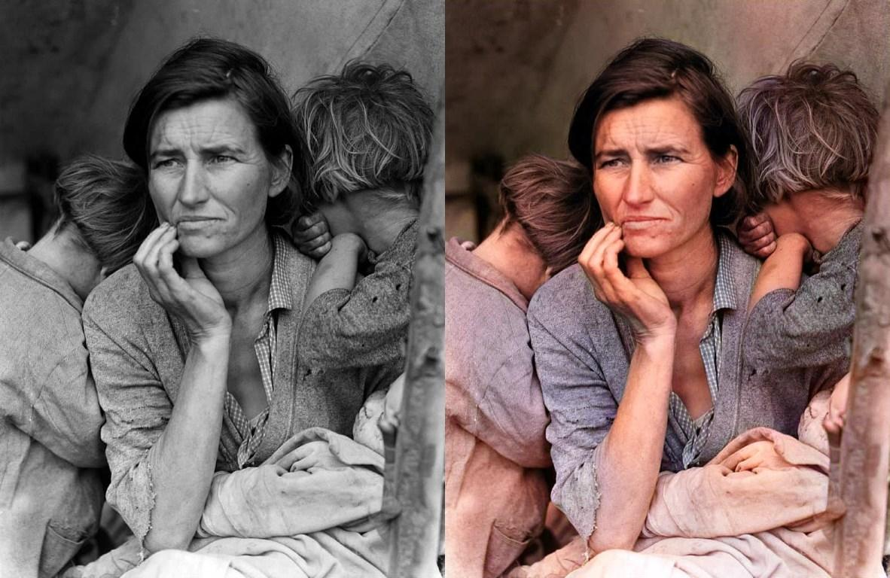
Applications

Slide 6
Generative Adversarial Networks(GAN’s)
Generator Network (G)
Image
Random vector

Slide 7

Generative Adversarial Networks(GAN’s)
Generator Network (G)
Random vector

Slide 8

Generative Adversarial Networks(GAN’s)
Generator Network (G)
Discriminator network (D)
Y =0
OR
Y = 1
Random vector
Database of real Images

Slide 9
Generative Adversarial Networks(GAN’s)
Run Adam on two mini batches (Real/Generated)
Update weights
Generator Network (G)
Discriminator network (D)
Y =0
OR
Y = 1
Random vector
Database of real Images

Slide 10
Generative Adversarial Networks(GAN’s)
Run Adam on two mini batches (Real/Generated)
Update weights
Generator Network (G)
Discriminator network (D)
Y =0
OR
Y = 1
Random vector
Trained few more steps
Database of real Images

Slide 11
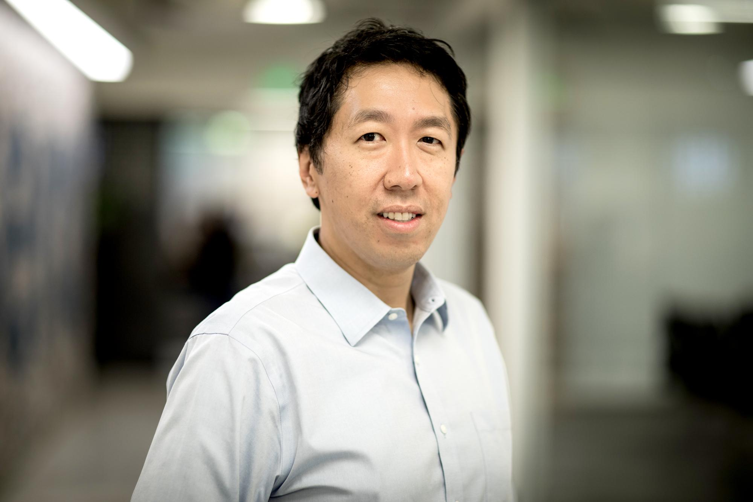

Slide 12
Don’t Worry about the math

Slide 13
Question
How should we evaluate the models performance ?

Slide 14
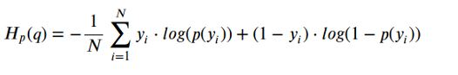
Losses
Discriminator Loss :
Binary cross entropy :
Real label of image
Output of discriminator

Slide 15
Losses
When Y = 1
Discriminator Loss :
Binary cross entropy :
Real label of image
Output of discriminator

Slide 16
Losses
Discriminator Loss :
Binary cross entropy :
Real label of image
Output of discriminator
Activated Y = 0

Slide 17
Losses
Case # 1 :
When Y = 1
Remember Y is the real Label
Discriminator Loss :
Binary cross entropy :
Log x
Real label of image
0
1
P(yi)
Output of discriminator

Slide 18
Losses
Case # 2 when Y = 0
Remember Yi is the real label of image “i”
Discriminator Loss :
Binary cross entropy :
Log(1-x)
Real label of image
0
1
P(yi)
Output of discriminator

Slide 19
Losses
Discriminator Loss :
Binary cross entropy :
y = 0
Log(1-x)
Real label of image
0
1
Output of discriminator
Total loss = cross_entropy from real images + cross_entropy from fake images

Slide 20
Losses
Note : here p(yi) is discriminator output prob not Generator output
Generator Loss :
Binary cross entropy :
Y will always be 1 in this loss
Output of discriminator

Slide 21
Losses
Note : here p(yi) is discriminator output prob not Generator output
WHY ?
Generator Loss :
Binary cross entropy :
Y will always be 1 in this loss
Output of discriminator

Slide 22
Losses
Note : here p(yi) is discriminator output prob not Generator output
WHY ?
Generator Loss :
Binary cross entropy :
Y will always be 1 in this loss
Output of discriminator
Because you are checking generators performance with respect to the discriminator e.g : how well you generator is doing at fooling the discriminator

Slide 23
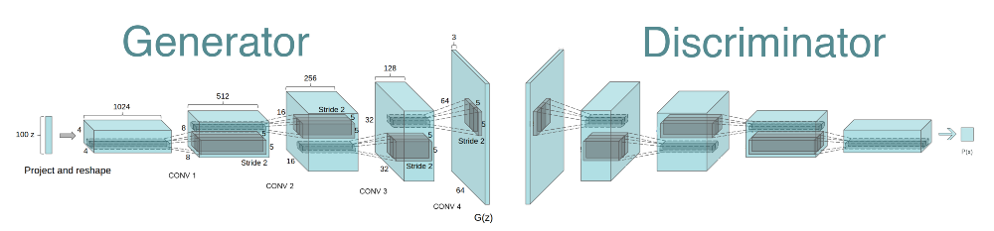
GAN Architecture

Slide 24
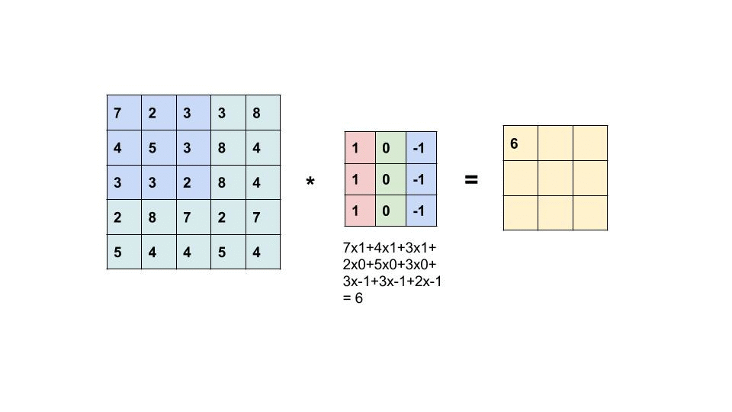
Let's Revise Convolutions

Slide 25
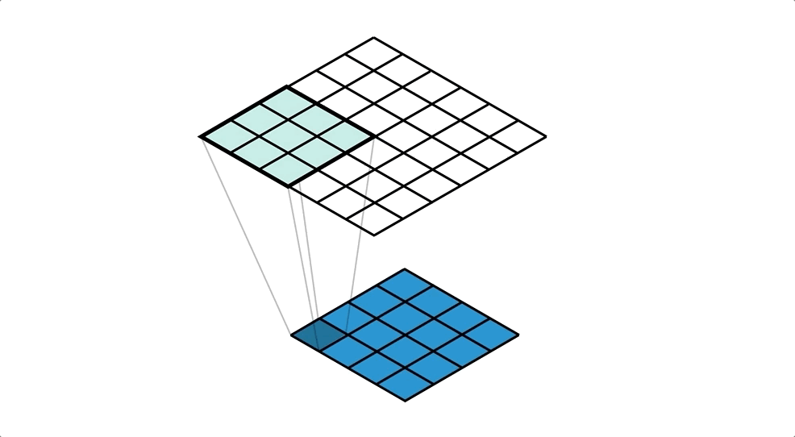
Transpose Convolution

Slide 26
LET'S LOOK AT THE CODE
Link to code :

Slide 27

Cycle GAN (Applications)
Image Domain transfer
Can also be replicated for voices (audio data)

Slide 28
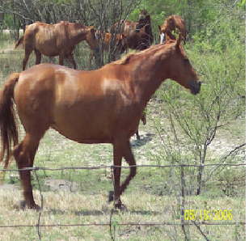
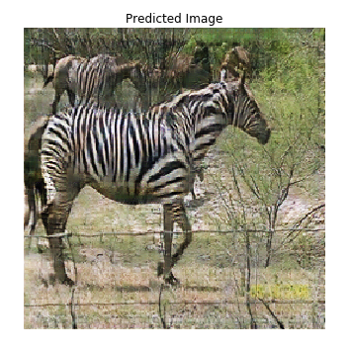
Cycle Gan architecture
Generator 1

Slide 29
Cycle Gan architecture
Generator 1
Discriminator
1
y

Slide 30
Cycle Gan architecture
Real images
Generator 1
Discriminator
1
y
Generator 2

Slide 31
Cycle Gan architecture
Real images
Generator 1
Discriminator
1
y
Real images
Discriminator 2
Generator 2

Slide 32


